Slide 1
Storage v3.0
Brainstorming :-)

Slide 2
!! constexpr !!

Slide 3
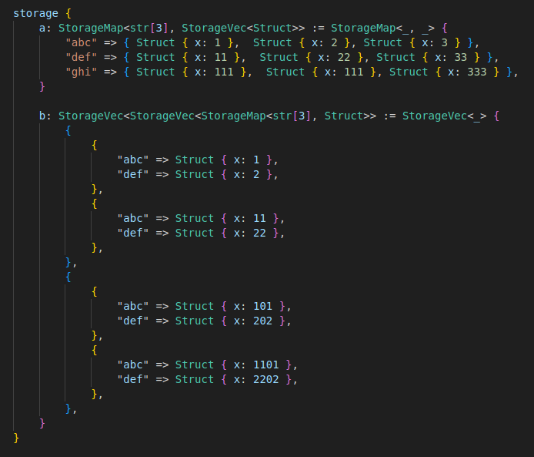
“configures to” operator

Slide 4
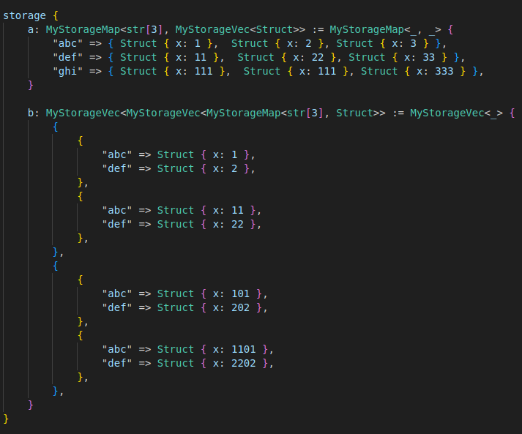

Slide 5
